Slide 1
Machine Learning
Course 1 - Fundamentals

Slide 2
Week 1 - Agenda
Instructors, Students, Syllabus, Policy
Machine Learning Overview
Mathematics Review (Linear Algebra, Calculus & Probability)
Introduction to Numpy/Scikit-learn libraries
Jupyter Notebook
Use Numpy to solve some simple problems

Slide 3
Instructors - Students
Students
Introduction
Expectation
Instructors
Introduction

Slide 4
Syllabus - Policy
Course Syllabus
Homeworks
8 homeworks: due 1 hour before the next class
Submission: Github/Gitlab/Bitbucket

Slide 5
Machine Learning Overview

Slide 6
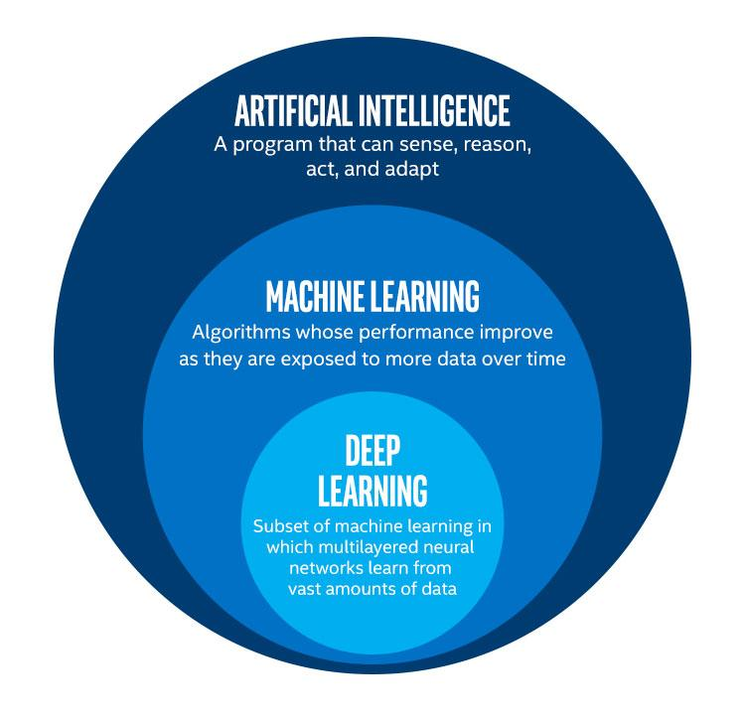
Definitions
Artificial Intelligence
Machine Learning
Deep Learning

Slide 7

What is Machine Learning?
Wikipedia:
Machine learning is the subfield of computer science that “gives computers the ability to learn without being explicitly programmed”
Notes:
Let's begin by talking about what machine learning is
Machine learning allows computers to learn from data
With traditional statistical modeling, we often know a good deal about the underlying process
Thus we can choose a method of analysis that closely approximates the underlying process and use this to develop a predictive model
With machine learning, we often know less about the underlying process or it is simply too complicated to express
Instead, we learn (or approximate) the equation from the data
Function approximation enables future values to be predicted using the machine learning model

Slide 8
Machine Learning in Our Daily Lives
Spam Filtering
Web Search
Postal Mail Routing
Fraud Detection
Movie Recommendations
Vehicle Driver Assistance
Web Advertisements
Social Networks
Speech Recognition
Notes:
And others.
So many applications, and still growing.
No stopping any time soon.

Slide 9
Types of Machine Learning
Supervised
trains algorithms using data points have known outcome
Unsupervised
trains algorithms using data points have unknown outcome
Semi-Supervised
trains algorithms using data points have both above types
Reinforcement
trains algorithms using a system of reward and punishment.
Notes:
The second is unsupervised machine learning where the outcome is not known for the data.

Slide 10
Supervised
trains algorithms using data points have known outcome
Supervised Learning data
Example # | X | Y
0 | X0 | Y0
1 | X1 | Y1
2 | X2 | Y2
3 | X3 | Y3
4 | X4 | Y4
5 | X5 | Y5
6 | X6 | Y6
Classification
Regression
Notes:
The second is unsupervised machine learning where the outcome is not known for the data.

Slide 11
Unsupervised
trains algorithms using data points have unknown outcome
Unsupervised Learning data
Example # | X
0 | X0
1 | X1
2 | X2
3 | X3
4 | X4
5 | X5
6 | X6
Clustering
Anomaly Detection
Dimensionality Reduction
Spare Representation
Independent Representation
Notes:
Unsupervised learning attempts to learn the structure hidden in a data set.
Towards a predefined type of representation like clustering, anomaly detection, Low Dim Representation, Spare Representation or independent representation.
Unsupervised learning takes no action and receives no feedback, it just operates on the X data set.

Slide 12
trains algorithms using data points typically have a small amount of labelled with a large amount of unlabelled data
Semi-Supervised
Semi-Supervised Learning data
Example # | X | Y
0 | X0 | Y0
1 | X1 | unknown
2 | X2 | unknown
3 | X3 | Y3
4 | X4 | unknown
5 | X5 | unknown
6 | X6 | unknown
Notes:
The second is unsupervised machine learning where the outcome is not known for the data.

Slide 13
Reinforcement
trains algorithms using a system of reward and punishment.
Reinforcement Learning Timesteps
TimeStep # | State | Action | Reward
0 | S0 | A0 | -1
1 | S1 | A1 | 0
2 | S2 | A2 | 0
3 | S3 | A3 | 0
4 | S4 | A4 | 0
5 | S5 | A5 | 1
6 | S6 | A6 | 1
Notes:
In reinforcement learning, a agent must learn which action to select at each time stamp.
Receiving a reward as feedback, usually sparse in nature.
This feedback instead of being the correct answer is a scalar number representing the relative goodness of the sequences
of action recently taken usually without a firm's starting point for the sequence.
The agent must learn the sequence that gives the highest total reward through trial and error.
Also in reinforcement learning, the next state and reward functions are usually stochastic.
The same action and the same state may produce different rewards and different next states for the agent.
We consider reinforcement learning to be a third type of machine learning.
Even though it may use supervised learning, or unsupervised learning as part of it's method, it is a distinct type of learning with its own set of challenges and methods

Slide 14
Introduction to
Supervised learning
Notes:
Now that we have finished our overview of machine learning, let's begin with our first supervised machine learning method
This method is called K – nearest neighbors, or KNN, for short

Slide 15
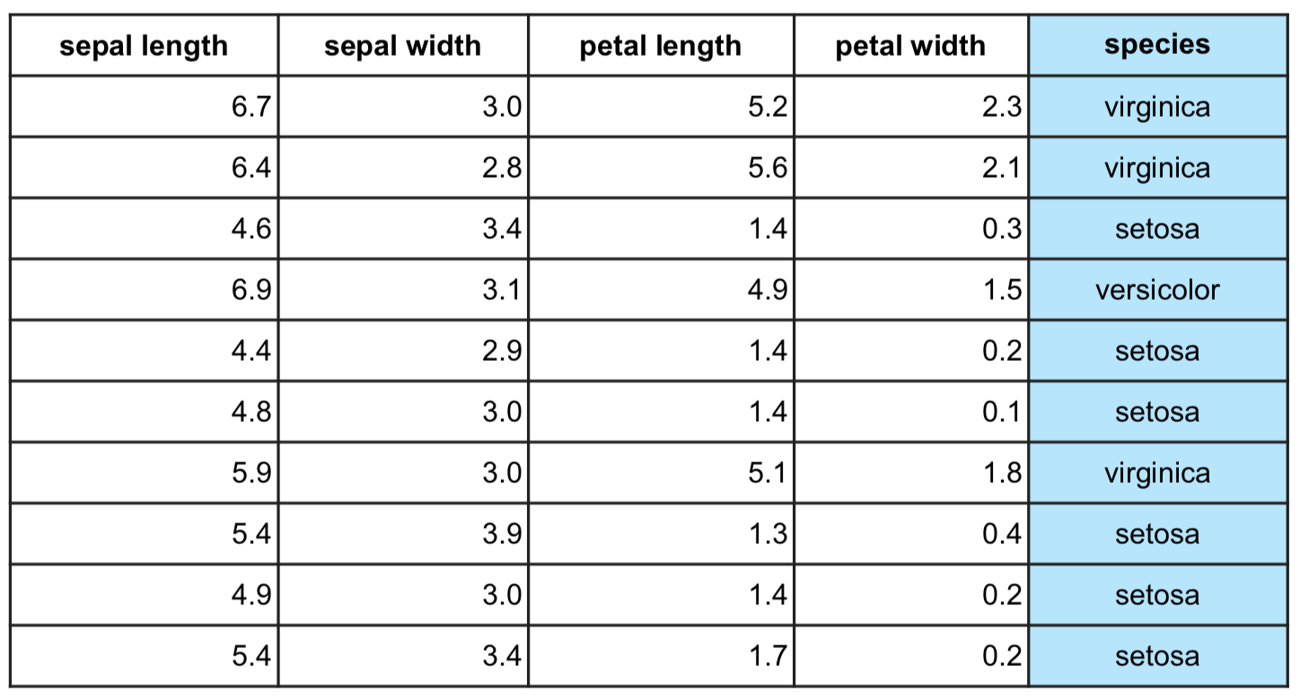
Target vs. Features
Target: Column to predict
Features: Properties of the data used for prediction (non-target columns)
Features
Target

Slide 16

Example: Supervised Learning Problem
Goal: Predict if an email is spam or not spam.
Data: Historical emails labeled as spam or not spam.
Target: Spam or not spam
Features: Email text, subject, time sent, etc.
SPAM?
Supervised Learning Program
NOT SPAM?

Slide 17
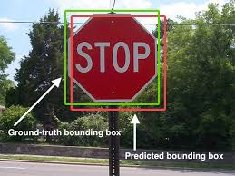
Example: Supervised Learning Problem
Goal: Predict location of bounding box around an object.
Data: Images with bounding box locations.
Target: Corners of bounding box
Features: Image pixels

Slide 18

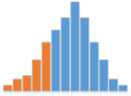


Workflow
Problem Statement
What problem are you trying to solve?
Data Collection
What data do you need to solve it?
Data Exploration & Preprocessing
How should you clean your data so your model can use it?
Modeling
Build a model to solve your problem?
Validation
Did I solve the problem?
Decision Making & Deployment
Communicate to stakeholders or put into production?

Slide 19
Formulating a Supervised Learning Problem
For a Supervised Learning Problem:
Collect a labeled dataset (features and target labels).
Choose the model.
Choose an evaluation metric: “What to use to measure performance.”
Choose an optimization method:¹ “How to find the model configuration that gives the best performance.”
¹There are standard methods to use for different models and metrics.

Slide 20
List of Common Supervised Learning Algorithms/Models
Linear Regression
Logistic Regression
Decision Tree
SVM
Naive Bayes
kNN
K-Means
Random Forest
Gradient Boosting algorithms: GBM, XGBoost, LightGBM, CatBoost
Notes:
For more details refer to ML 101

Slide 21
Which Model?
Some considerations when choosing are:
Time needed for training
Speed in making predictions
Amount of data needed
Type of data
Problem complexity
Ability to solve a complex problem
Tendency to overcomplicate a simple one
Notes:
For more details refer to ML 101

Slide 22

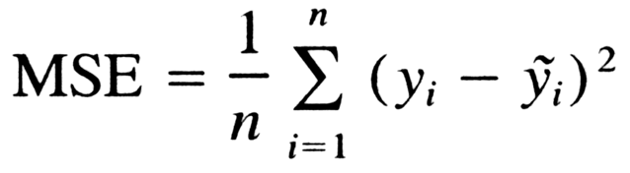
Evaluation Metric
There are many metrics available¹ to measure performance, such as:
Accuracy: how well predictions match true values.
Mean Squared Error: average square distance between prediction and true value.
Accuracy target
Mean square error formula
¹The wrong metric can be misleading or not capture the real problem.

Slide 23
Evaluation Metric
The wrong metric can be misleading or not capture the real problem.
For example: consider using accuracy for spam/not spam.
If 99 out of 100 emails are actually spam, then a model that is predicting spam every time will have 99% accuracy.
This may force an important real email into spam, even though it has a high accuracy metric.
Email
Notes:
A spam email in inbox: annoying
A real email in the spam folder: missing something important

Slide 24
Training
Training Data: The dataset used to train the model.
Optimization: Configures the model for best performance.

Slide 25



Training
With these pieces, a model can now be trained to find the best configuration.
Human
Bicycle
Forward
“Bicycle!”
“Strawberry?”
?
Error
Strawberry
Backward
Labeled Data
Model
Evaluation Metric

Slide 26

Inference
Once the model is trained, we can provide new examples for predictions.
“Bicycle!”
??????
New Data
Model
Prediction

Slide 27
Training vs. Inference
Goal: Perform well on unseen data during inference.
Human
Bicycle
“Bicycle!”
“Strawberry?”
Training
?
Model weights
Error
Strawberry
Inference
“Bicycle!”
??????

Slide 28
Supervised Learning Overview
Training: Train a model with known data.
Data with answers
(features and labels)
Fit
Trained
Model
+
Model
Inference: Feed unseen data into trained model to make predictions.
Data without answers
(features only)
Trained
Model
Predict
Predicted
Answer
+

Slide 29
Curve Fitting: Overfitting vs. Underfitting Example
Goal: Fit a curve to the data.
Y
X

Slide 30
Curve Fitting: Underfitting Example
The curve can be too simple.
This is called “underfitting”
Poor fit on training data
Poor fit on unseen data
Underfitting: Model is missing systematic trends in data.
Y
X

Slide 31
Curve Fitting: Overfitting Example
The curve can be too complex.
This is called “overfitting”
Good fit on training data
Poor fit on unseen data
Overfitting: Model is too sensitive and fits the “noise” in the training data.
Y
X

Slide 32
Curve Fitting Problem
Problem: Unseen data isn’t available during training.
How can performance be estimated?
When measuring performance on the training data, there is a tendency to overfit.
Underfit
Well fit
Overfit

Slide 33
Solution: Split Data Into Two Sets
Training Set: Data used during the training process.
Test Set: Data used to measure performance, simulating unseen data¹.
Training Set
Testing Set
¹ Not used during the training process.
*Other names and brands may be claimed as the property of others.

Slide 34
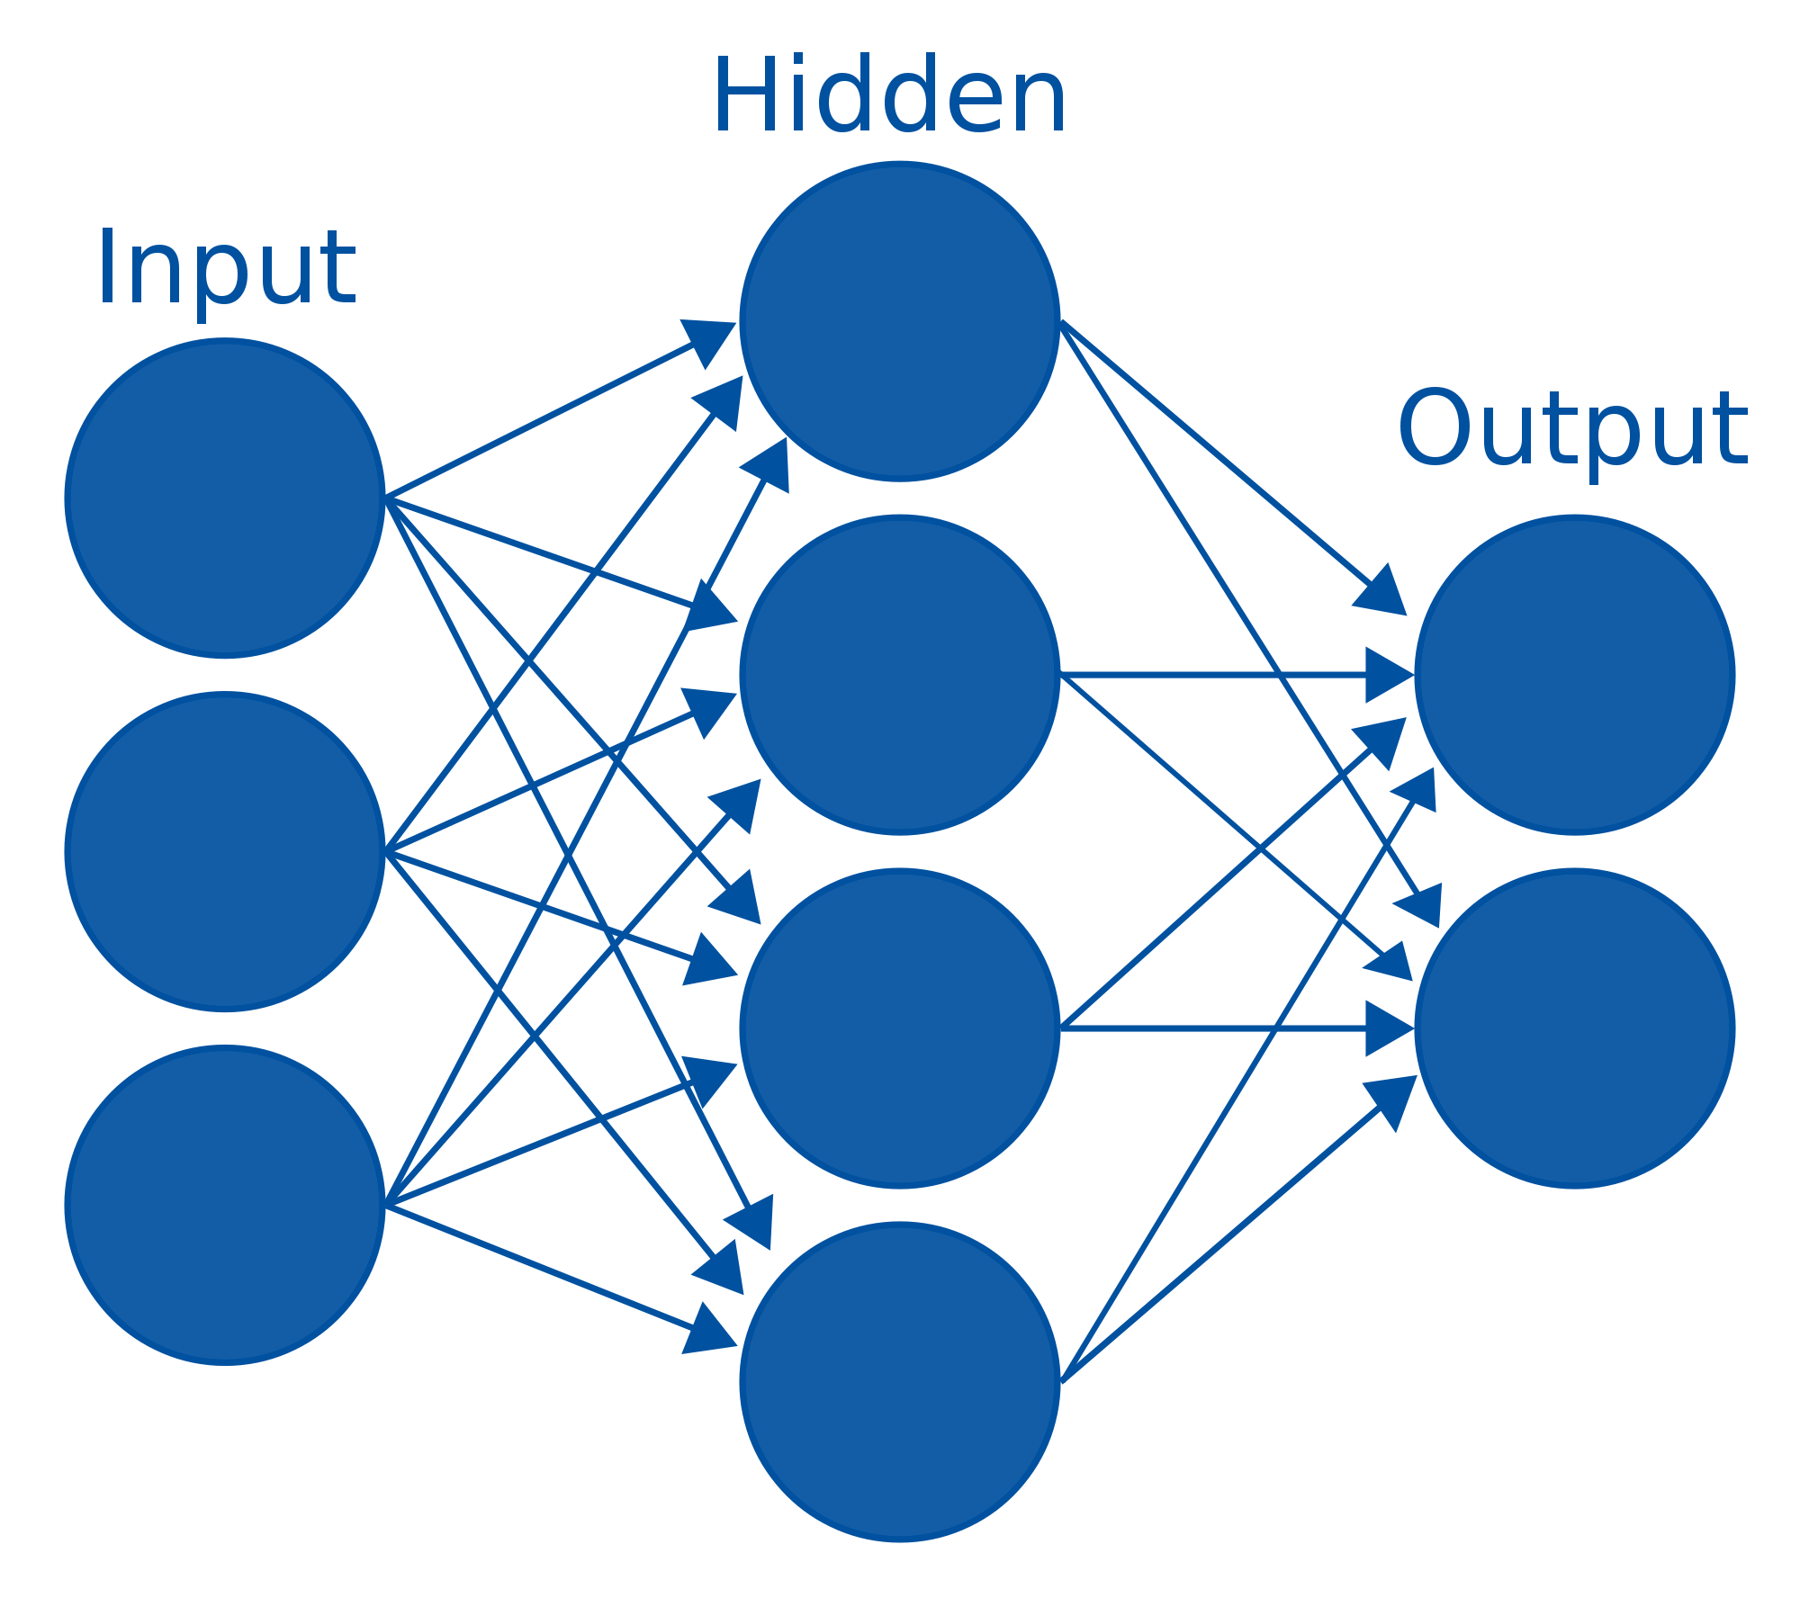
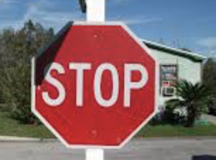





Train-Test Split
Evaluate trained model on data it hasn’t “seen” before
to simulate real-world inference.
“Trained Model”
Training
Training Data
Model Weights
Prediction
Inference
Testing Data

Slide 35
Python, Jupyter Notebook, Colab

Slide 36

Programming Tools
Anaconda is the world’s most popular Python data science platform (Everything you need 'out of the box').
​Includes: ​
Spyder (IDE/editor - like pycharm) and Jupyter
Download: https://www.anaconda.com/download/

Slide 37

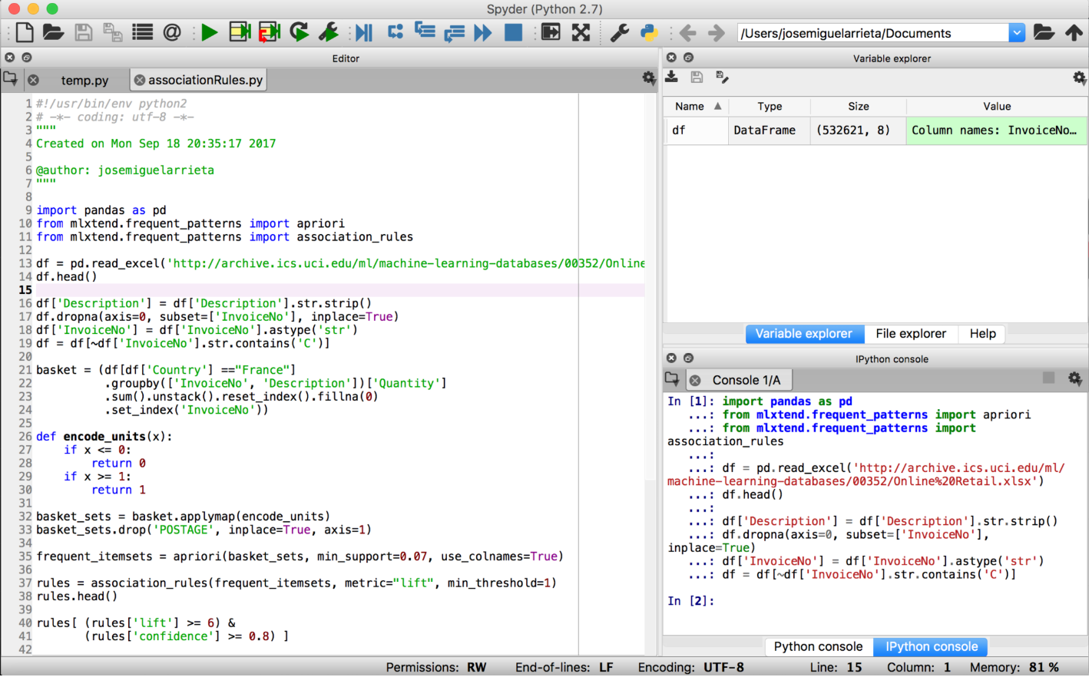
Programming Tools - Spyder
Spyder is the Scientific PYthon Development EnviRonment
Spyder is an
Integrated Development Environment (IDE)

Slide 38

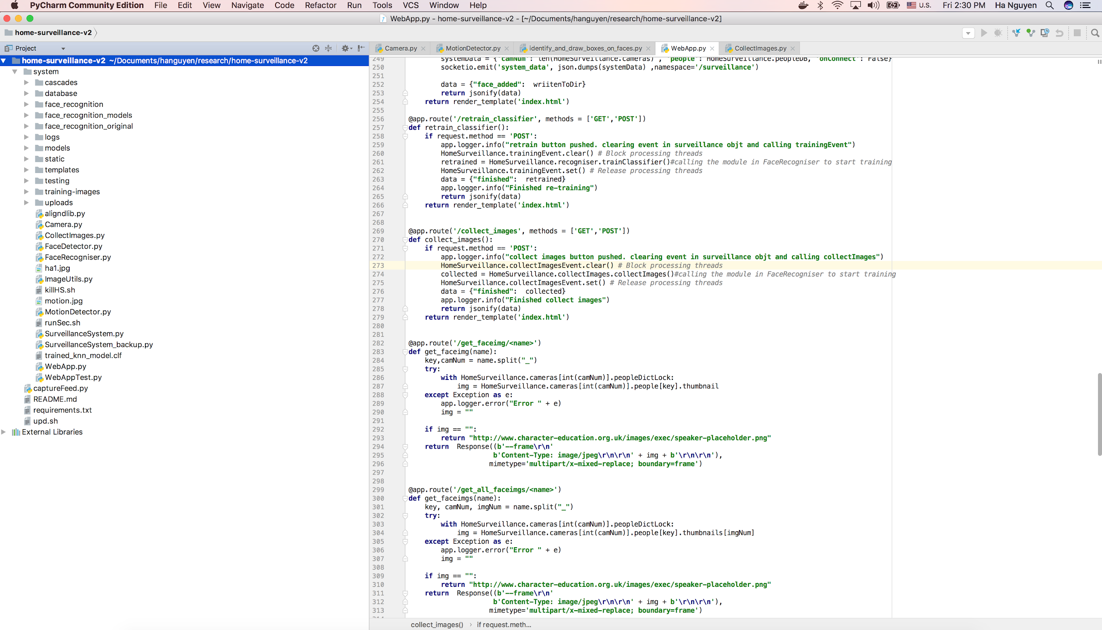
Programming Tools - PyCharm
PyCharm is an
Integrated Development Environment (IDE)

Slide 39

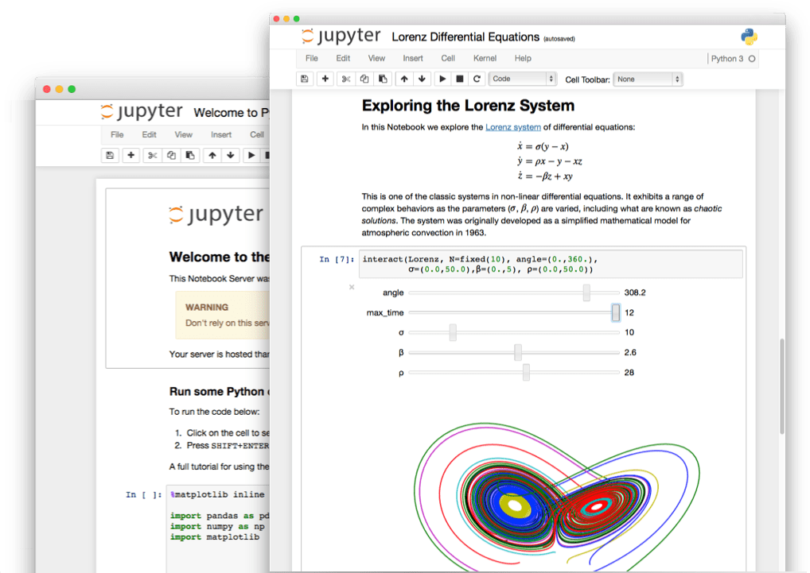
Programming Tools - Jupyter
The Jupyter Notebook is an open-source web application that allows you to create and share documents that contain live code, equations, visualizations and narrative text.
https://nbviewer.jupyter.org/github/waltherg/notebooks/blob/master/2013-12-03-Crank_Nicolson.ipynb

Slide 40





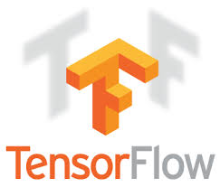

Python* Libraries
Data analysis and manipulation
Fast numerical computing
Machine learning
Visualization
Deep Learning
*Other names and brands may be claimed as the property of others.

Slide 41
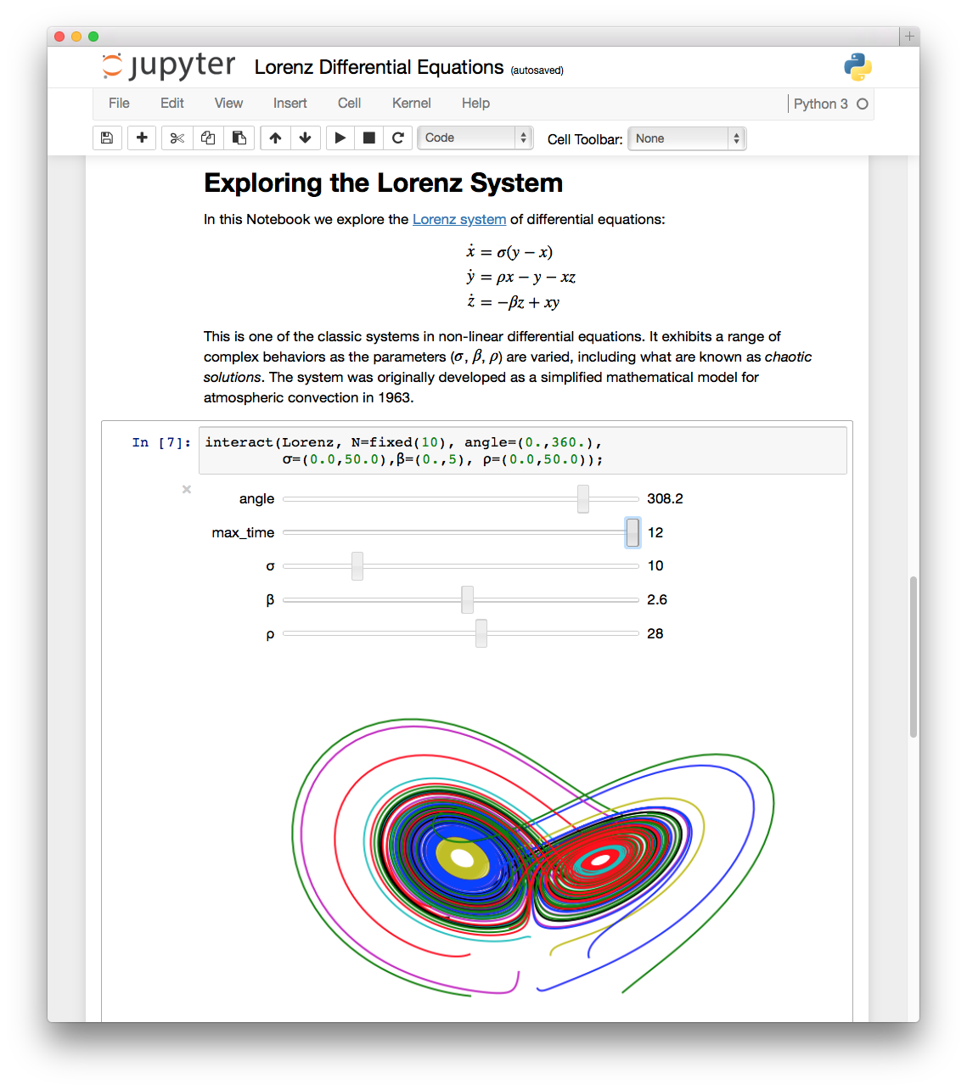
Introduction to Jupyter Notebook
Polyglot analysis environment—blends multiple languages
Jupyter is an anagram of: Julia, Python, and R
Supports multiple content types: code, narrative text, images, movies, etc.
Source: http://jupyter.org/
Notes:
Let’s start by looking at Jupyter notebooks.
It gives us an in-browser environment, interactive coding experience. And we can use multiple languages.

Slide 42
Introduction to Jupyter Notebook
Polyglot analysis environment—blends multiple languages
Jupyter is an anagram of: Julia, Python, and R
Supports multiple content types: code, narrative text, images, movies, etc.
Source: http://jupyter.org/
Notes:
Julia Python and R. We’re going to stick to Python.

Slide 43
Introduction to Jupyter Notebook
Polyglot analysis environment—blends multiple languages
Jupyter is an anagram of: Julia, Python, and R
Supports multiple content types: code, narrative text, images, movies, etc.
Source: http://jupyter.org/
Notes:
You can write code, add beautiful markdown text, images, insert youtube videos etc.

Slide 44
Introduction to Jupyter Notebook
HTML & Markdown
LaTeX (equations)
Code
Source: http://jupyter.org/
Notes:
Its structure is, essentially, a sequence of “cells”
A cell contains either HTML/MD
Or Latex
Or Actual Code

Slide 45
Introduction to Jupyter Notebook
HTML & Markdown
LaTeX (equations)
Code
Source: http://jupyter.org/
Notes:
Here in this picture, it starts with a Markdown cell.
It has a header and some text explaining what we are about to do.
Kind of like commenting but much prettier.

Slide 46
Introduction to Jupyter Notebook
HTML & Markdown
LaTeX (equations)
Code
Source: http://jupyter.org/
Notes:
It is then followed by some Latex equations.

Slide 47
Introduction to Jupyter Notebook
HTML & Markdown
LaTeX (equations)
Code
Source: http://jupyter.org/
Notes:
And finally some code, which can define variables, modify them, basically do everything what code can do.
Here, it is creating an interactive plot of a Lorenz System, in the notebook.
All of this combined creates the perfect tool that connects programming with storytelling.
This makes Jupyter notebooks the best friend of a data scientist.
The work is saved to a .ipynb file which can be converted to html, pdf etc. to create beautiful websites / presentations.

Slide 48
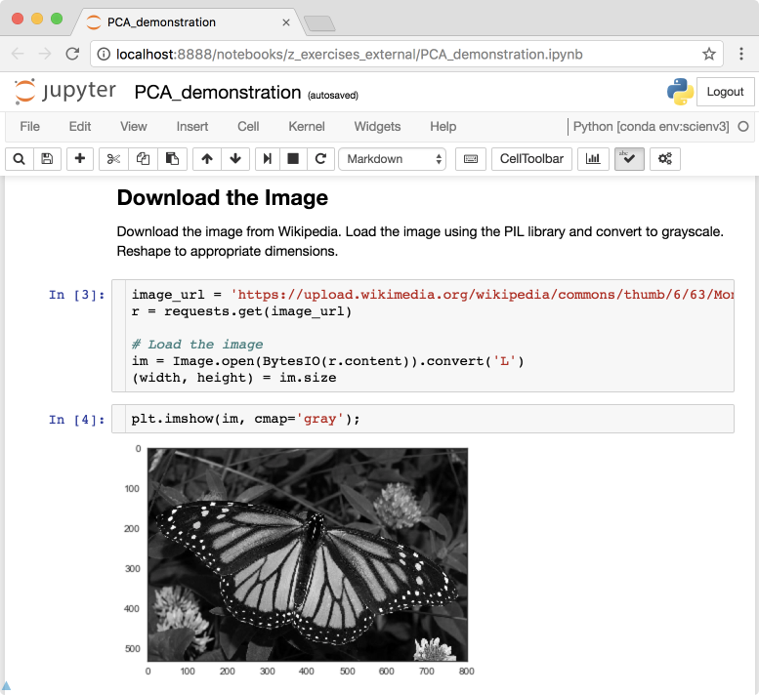
Introduction to Jupyter Notebook
Code is divided into cells to control execution
Enables interactive development
Ideal for exploratory analysis and model building
Notes:
Let’s look at how the code flows throughout a notebook:
It is divided into cells. This enables the user to
stop and look at what happened
what is the state of the variable
Write new code in the next cell
etc
This is the interactive development that is great for exploring the data and model building.

Slide 49
Introduction to Jupyter Notebook
Code is divided into cells to control execution
Enables interactive development
Ideal for exploratory analysis and model building
Notes:
One drawback of this could be that the user can hurt themselves if they run cells in the wrong order.
The Kernel runs in the order that cells are executed, not necessarily in the order they are in the browser.

Slide 50
Thank you

